Slide 1
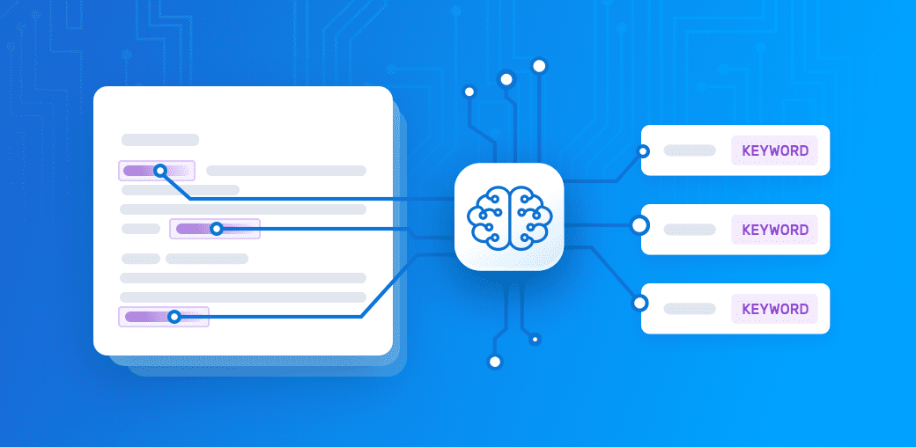
Keyword extraction

Slide 2
Traditional keyword extractor
Based on RAKE
Struggles with N-grams
Inefficient with academic literature

Slide 3
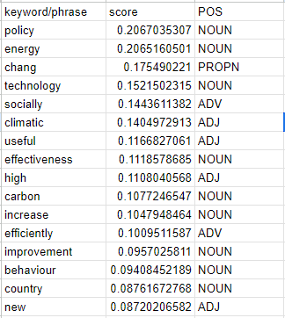
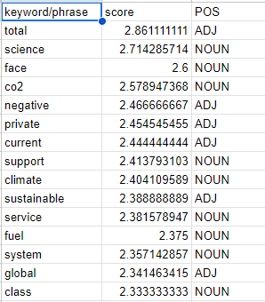
TF-IDF keywords
Rake keywords

Slide 4
Token Classifiers
ML algorithm in NLP
Easily trainable for a specific data set
Unphased by N-grams

Slide 5
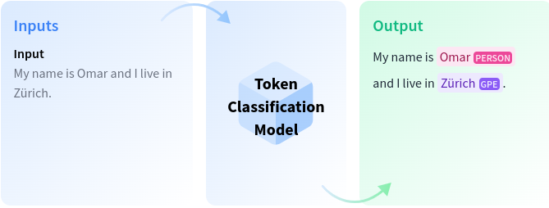

Slide 6
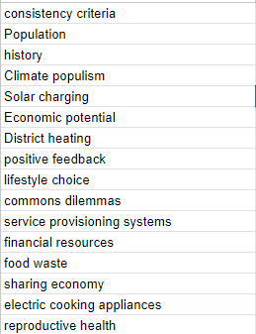
Keywords Extracted using Hugging Face models
Better quality
Efficient with Academic literature
Extracts phrases

